Slide 1
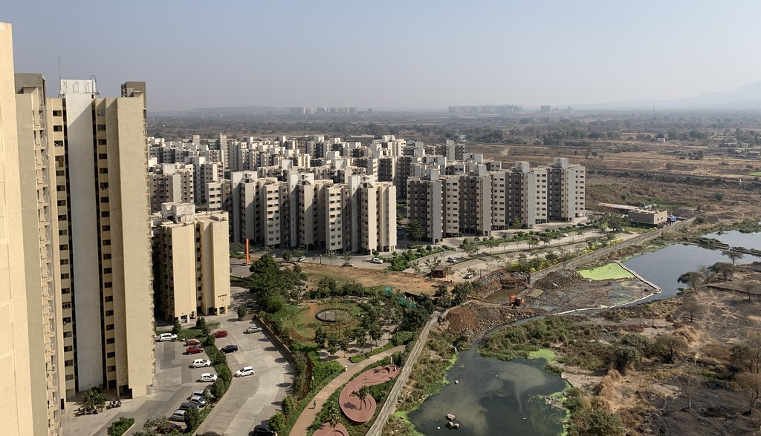

Palava City:
A pathway to net zero energy by 2030

Slide 2
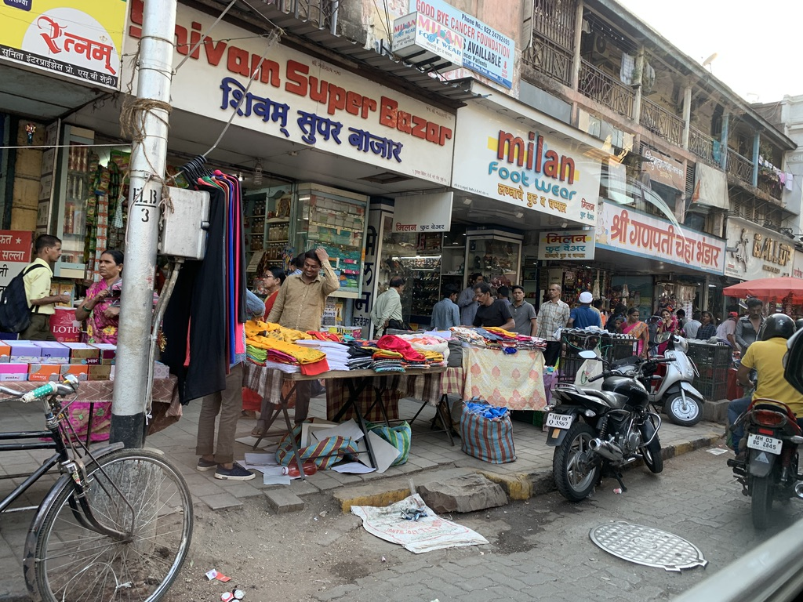
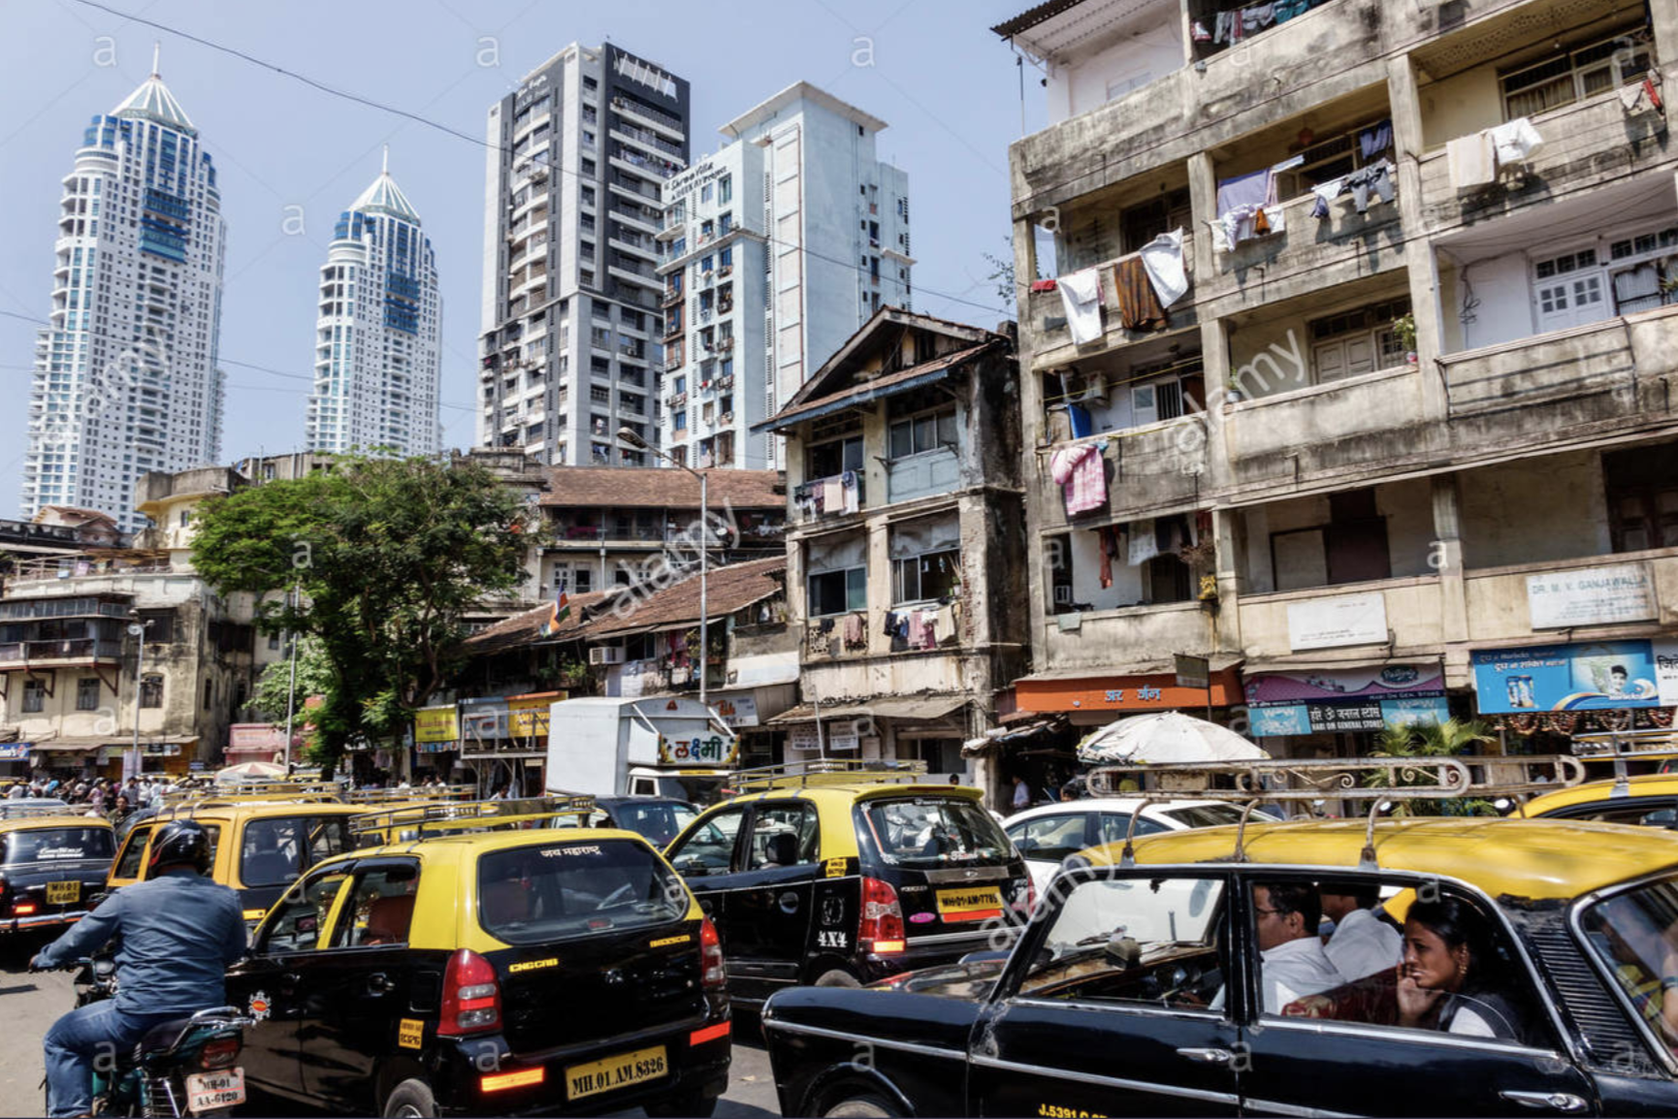

Slide 3
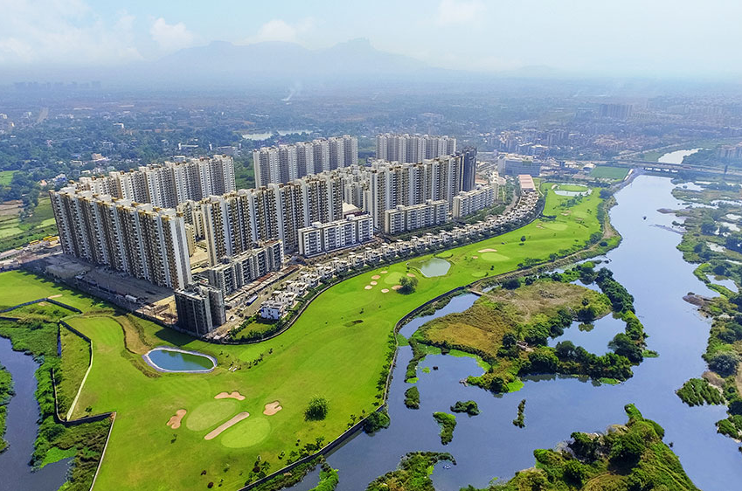

Slide 4
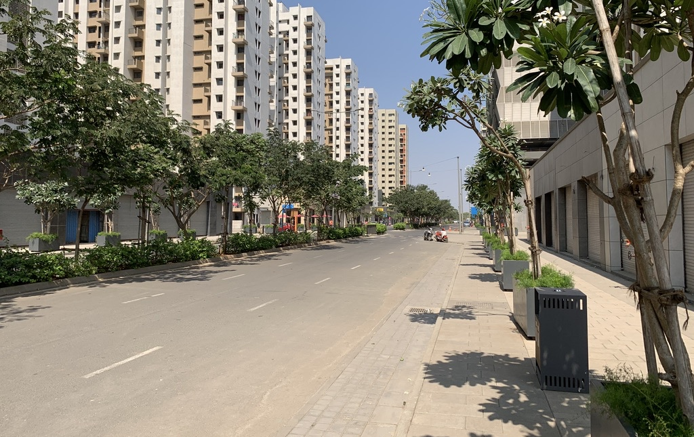
Project Overview
Palava is a 4,500 acre (20 Sq. km) green field city
Located in Mumbai Metropolitan Region (MMR) 45 km from financial hub of South Mumbai
Planned 7 million Sq. ft. of office space and 100,000 apartments in two phases by 2025
Residential - 28,000 homes built and occupied as of November 2017,
Commercial - 650,000 Sq. Ft. of office spaces available by March 2019

Slide 5
Palava Development Phases
Palava I
(Completed)
18,600 flats
16,500 occupied
X 3.4 people / flat
= 56,100 people
Palava II (Underway)
Focus of project and recommendations is on Palava II
NZE transition strategy is focused on Palava II
Mobility survey data used as basis for Palava II mobility strategy recommendations
80,000 flats
X 3.4 people / flat
= 272,000 people
We want Palava to rank among the top 50 most livable cities in the world by 2025; this is ambitious, because at the moment, no Indian city is ranked in the top 100. We will have half a million people living in Palava in 2025, with 100,000 jobs in and around the city.
Palava III
(Future)
- Abhishek Lodha

Slide 6
Overview of Project Scope
An integrated approach to sustainability design and planning
Minimize onsite energy use, and
Maximize onsite energy generation
(see next slide)
Net Zero Energy
Energy Use and Efficiency
Renewable
Energy
Reduce mobility related GHG emissions, increase walkability, and enhance livability:
+
Shift to non-motorized-transport [NMT] commuting,
Enable electrification of mobility, and
Develop on-site RE generation to charge public and private electric vehicles
Sustainability Roadmap
Provided prioritized sustainability strategies in Assessment Phase
Project scope delayed as Lodha collects additional requisite background data
Mobility
Water Use
Mobility demands, solutions, and infrastructure
Water use quantity, patterns, and infrastructure

Slide 7
Net Zero Energy Buildings and Net Zero Carbon Mobility
Framework for identifying abatement strategies and estimating progress toward NZE
Baseline Projected Energy
Progress toward NZE Goal
Abatement Strategies
Efficient Design
  Architectural & MEP
Reduced Consumption
  Behavioral
  Mobility NMT and EV Strategies
Onsite Generation
Abated Energy
Grid Purchased Energy
Residential Flats
Residential Common
Commercial – Tennant
Commercial – Common
Schools
Clubs
STP/UGT
Amenities and misc.
Retail
Abated Energy
Analyses
Mobility Energy
Feasibility Analysis
LCC Analysis
EUI Targets
Design Standards
Enhanced Design Policies
Grid Purchased Energy
Commute fuel
Non-commute fuel
Mobility Fuels

Slide 8
Palava Phase II Pathway to becoming a Net Zero Energy City
75% energy savings potential identified for Phase II ¹
Key Takeaways
Mobility is projected to account for 64% of the energy and 43% of the CO2 emissions in 2030 under BAU
Reducing commute and promoting NMT for inner-city travel has energy abatement potential of 56%; highest impact on energy and carbon emissions in the city
Buildings under BAU ~20% better than BEE average. Building loads abated by 24% through efficiency strategies (9% of city energy), will be >40% below BEE average¹
Add’l building load offset by 24% with onsite PV (9% of city energy)
Remaining city-wide energy is 25% (19% from buildings and 6% from mobility)¹
  Mobility Footprint
Mobility
  Buildings Footprint
Amenities
Commercial
Residential
See Appendix for detailed calculations, See slide 11 for EUI comparison with Bureau of Energy Efficiency (BEE) benchmark EUI
Only accounting for strategies fully quantified in the Analysis Phase. Additional abatement opportunities, including natural ventilation, efficiency and massing strategies exist that were not yet fully quantified
See slide 53 – 56 for description of additional strategies that warrant further analysis to achieve higher level of abatement

Slide 9






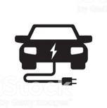
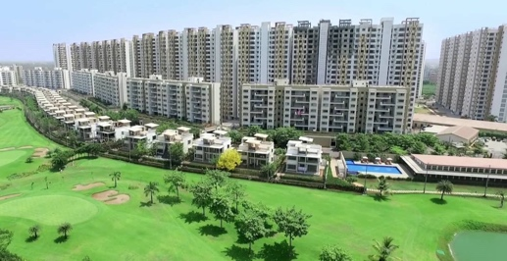





Transition Strategy for Palava to be a Model NZE City by 2030
Building and Mobility energy use abatement strategies¹
75% abated energy quantified; 25% or more additional abatement opportunities remain to be quantified
  Onsite Generation - Residential PV
  Rooftop PV for 100% common area (0-2 yr)
  Vertical Mount and Overhang PV (2-5 yr)
6%
2030
Roadmap
to
NZE
40%
10%
28%
  Commercial Efficiency Strategies
  EUI reduction through efficient plant design, VFDs, improved HVAC controls & piping design (0-2 yr)
Commercial
  Onsite Generation - Commercial PV ²
  Commercial rooftop PV (0-2 yr)
  4 - 15 MW PV (large scale open access plant) (2-5 yr)
14%
8%
  Central Plant / District Cooling
  Central plant for Sector 2 (0-2 yr)
  District Cooling considered (2-5 yr)
Onsite Generation
8%
  Onsite Generation - Amenities PV
  School rooftop PV for NZE schools (0-2 yr)
  Clubhouse rooftop PV for NZE clubs (0-2 yr)
3%
  Residential Building Passive Design¹
  Insulated Concrete Forms (ICFs) (2-5 yr)
  High Solar Reflective Index (SRI) paint (0-2 yr)
  Onsite Generation – PV for EV Power
  MLCP rooftop PV (for EV or other captive load) (0-2 yr)
  Carport PV street level (2-5 yr)
11%
3%
Residential
56%
  Residential Buildings Behavioral and Equipment Efficiency Programs
  Energy efficiency awareness programs (0-2 yr)
  Energy efficient appliances program (0-2 yr)
69%
7%
  NMT and EV Commuting Solutions
  Enabling live-work targets, NMT network (2-5 yr)
  Inner Palava mobility NMT & EV
  Buildout of EV infrastructure (2-5 yr)
Mobility
19%
Note: City level percentages in black; sub-sector level percentages in green (i.e. Residential, Commercial, Amenities, and Mobility).
Total abatement of 75%, does not account strategies not directly quantified in Analysis Phase that can bring 25% unabated energy closer to NZE, e.g. Natural Ventilation, virtual PPA’s, as well others noted in slides 53 – 56
Microgrid strategy is under evaluation for Commercial Sector, but not included here as impact on NZE not yet quantified
ICFs and SRI combined will result in abating 31% of the residential apartment energy use

Slide 10
Net Zero Building Energy Recommendations and Outcomes
Approach
Three Pillars of Net Zero Energy buildings set Palava on the road to being a NZE city:
Improved envelope and thermal performance to reduce loads,
Energy efficiency strategies through efficient equipment and controls, and
Onsite renewable energy generation
Major Recommendations
Residential
Improved envelope performance
Passive Design techniques
Efficient appliances
Behavioral programs
Commercial
Cooling load reductions
HVAC control strategies
Improved Piping design
Optimize day lighting and glare reduction
Central Plant / District cooling
Onsite Generation
Rooftop PV plants
Open access contracts
Ground mount PV plants
Vertical and carport PV potential
Outcomes
Metrics
      Building EUI is the predominant metric for building performance¹
Energy End Use | Baseline EUI (kWh/m2/yr) | Abated EUI: EEMs only (kWh/m2/yr) | Abated EUI: EEMs + PV (kWh/m2/yr) | BEE ² Benchmark EUI | % Difference (BAU vs BEE Avg) | % Difference (Abated EEMs Only vs BEE Avg)
Residential Flat | 32 | 25 | 18 | 44 | 28% | 42%
Residential Common Area | 15 | 15 | NZE | -- | -- | --
Commercial Buildings | 156 | 100 | 78 ¹ | 182 | 14% | 45%
Schools | 14 | 14 | NZE | -- | -- | --
Club House | 101 | 101 | NZE | -- | -- | --
Further reductions to EUI to 66 are possible considering case studies and super efficient chiller design. In addition, Net Zero Energy (NZE) may feasible in commercial buildings with Open Access renewable energy contracts contingent on regulatory restrictions and utility pricing
Bureau of Energy Efficiency benchmark EUI

Slide 11
Low Carbon Mobility Recommendations and Outcomes
Approach
Three Pillars to Low Carbon Mobility
      Minimize long distance commuting in personal petrol vehicle
      Maximize share of non-motorized transport within Palava
      Enable electric vehicle use and adoption
Non-Motorized Transport
Electric Vehicle Readiness
Major Recommendations
      Design guidelines for increased walkability
      Design guidelines for increased cycling
      Recommendation for NMT network layout
  Residential EV adoption forecast and required charging infrastructure
  EV charging load forecast (kWh & kW)
  Charging infrastructure guidelines
  Electrical infrastructure sizing upgrade timeline
Outcomes
Palava can achieve 86% reduction in commuting and 95% of leisure travel GHG by shifting to non-motorized-transport [NMT] commuting, enabling electric transportation, and developing on-site PV to charge vehicles
Mobility Energy Consumption | Baseline 2030 ¹ [kWh/yr/person] | Abated Scenario 2030 ¹ [kWh/yr/person] | Percent Reduction
Mobility: Commute (kwh/person) | 2,445 | 336 | 86%
Mobility: Leisure (kwh/person) | 620 | 29 | 95%
Used these per capita numbers multiplied by a commuter population of 257,000 (from SJ report) to calculate Phase II mobility footprint
See Appendix for detailed calculations

Slide 12
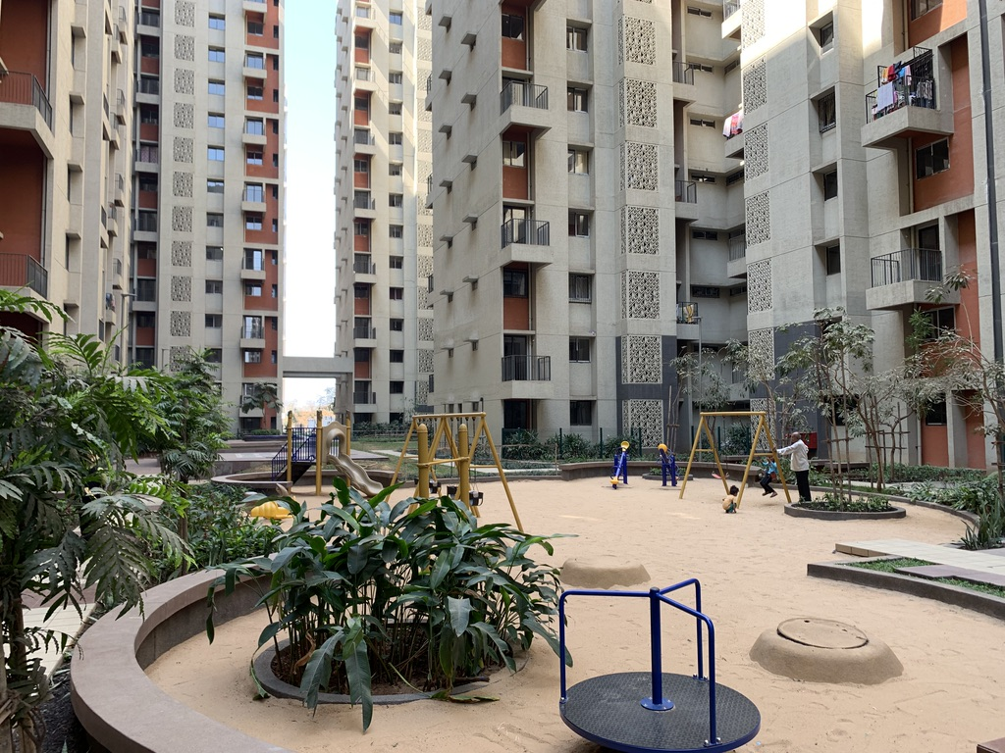
Thank you

